Slide 1

Product Presentation
Kailas Ghanekar

Slide 2

Px
IRON
PREVENT FROM ANAEMIYA
Px
FOLIC ACID
PREVENT FROM FOLATE TRAP
Px
B12
FOR GASTRIC ACID SECRATION
Px
PROTIN
INCREASE IRON ABSORPTION
HEPATOGLOBINE
Power of 4 Elements

Slide 3

Appetizer & Metabolizer
Elixir Neogadine

Slide 4

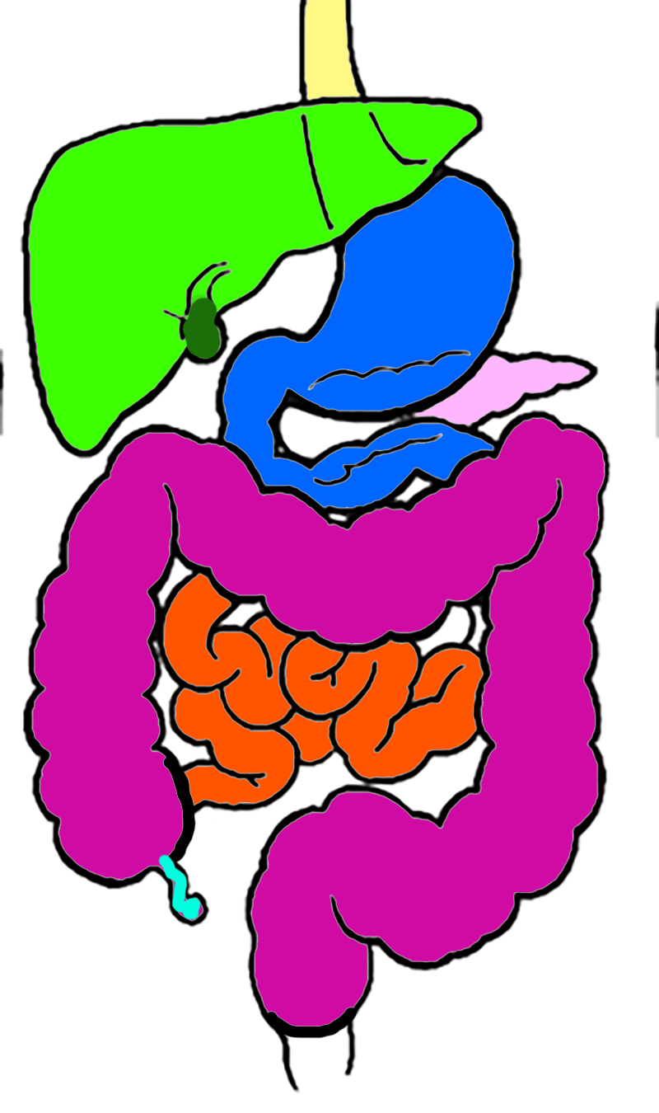
Neopeptine
Digestion
Indigestion
Alpha Amylase
Papain
Neopeptine

Slide 5
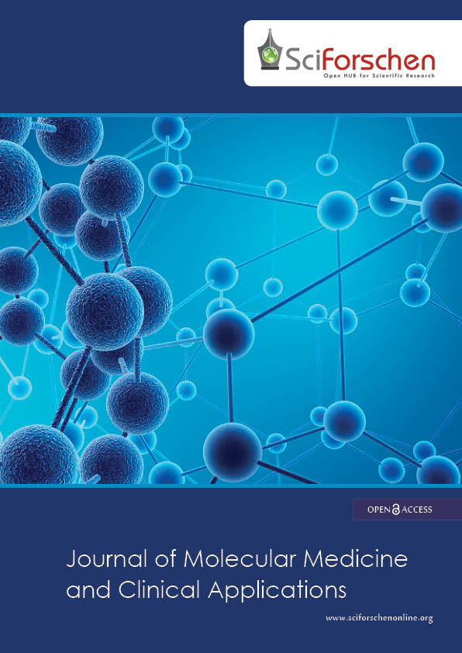

Slide 27
zytee
Choline Salicylate
Benzalkonium Chloride
Mouth Alcer gel

